Slide 1
Microsoft Storage Directions and SMB23 futures
Thomas Pfenning, General Manager
Jim Pinkerton, Partner Architect

Slide 2
Short History of SMB >1
SMB 2
20 Commands
Durable handles
Concurrency and compounding
High bandwidth delay product
Fairness with credits
SMB 2.1
Resilient handles
Leasing
Branch Cache
Large MTU
SMB 3
Persistent handles
Transparent failover
Active-Active
Multichannel
Branch Cache update
SMB Direct
Directory Leases
Remote VSS
Witness Protocol
Claims based authorization

Slide 3
Windows Server 2012 Storage Platform
Benefit Capability Features
Availability
Maximize service/data availability
New NTFS CHKDSK and Health Model
Lower Capital Expenditure
Storage Virtualization
Storage Spaces
Next-generation scale, availability, and data integrity
ReFS
Storage Efficiency
Deduplication
Lower Operational Expenditure
Ease of storage administration
Storage Management API with PowerShell & SMI-S integration
Maximize
Existing Hardware
Efficient capacity utilization
Thin Provisioning Integration
Dynamic Data Movement
Offloaded Data Transfer

Slide 4
CHKDSK – A Modern Approach
File system issues identified while the volume is online
Pre-verification of corruption to ensure CHKDSK only runs when needed (eliminates false positives)
Online scanning determines repair steps that need to be taken
Minimized Downtime for Correction
Online self-healing to immediately repair if possible
Volume can be taken offline at the administrator’s discretion for minimal time for targeted repair of the issue (seconds)
Cluster integration for Continuous Availability
Online spot-fixing of errors w/no down-time enabled via integration of Cluster Shared Volumes
500 GB
avg. size today
64 TB
with Windows 8

Slide 5
Storage Spaces
Redundant storage
Mirrored Spaces and Parity Spaces with integrated journaling
Cluster Support
Elastic capacity expansion
Simply add more physical drives
On-demand provisioning with reclamation (trim/unmap) support
For use by NTFS, Hyper-V, and other applications e.g. SQL
Managed via Windows Storage Management API
Server Manager GUI and Powershell
Rapid Recovery – per pool hot spare support
Application driven intelligent error correction
Granular administrative control with tenant isolation
Thinly-provisioned Spaces contained within Pools
8TB
Space
8TB
Space
8TB
Space
24TB
Pool
8TB
Space
8TB
Space
8TB
Space
24TB
Pool
Company A Pool
Company B Pool
Industry standard physical storage
48 TB physical storage
Contoso Hosting Company

Slide 6
The Resilient File System (ReFS)
Data Integrity
All metadata corruption is always detected. Optionally, user data corruption is also detected.
ReFS utilizes data redundancy offered by Storage Spaces to auto-correct metadata corruptions. Optionally, user data is similarly auto-corrected
Availability
ReFS maximizes dataset (volume) availability
If corruption occurs and a redundant copy is unavailable, the corrupt portion of the namespace is removed even as non-corrupt portions remain unaffected and online
Scalability
ReFS efficiently scales to PB+ datasets comprising very large files or directories
Architectural Evolution
Architecture enables efficient evolution for new storage devices, new data types, and new access patterns.
ReFS compatibility
Support for failover clustering but no Clustered Shared Volumes
NTFS features that ReFS does not support
Reparse Index
Hard Links
Named Streams
Extended Attributes (EA’s)
Object ID’s
Short Names
Fast MFT-like Enumeration
NTFS Compression
NTFS Encryption
NTFS Quotas
TxF
Deduplication

Slide 7
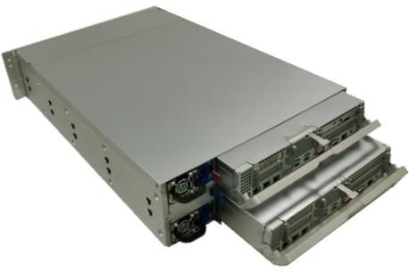
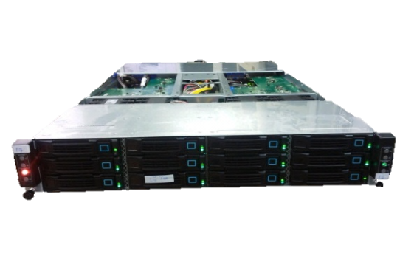
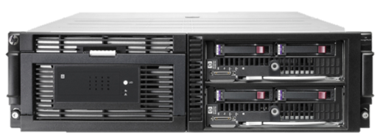
SMB 3 Cluster-in-a-box Systems
 | HP X5000 | Wistron (ODM) | Quanta (ODM)
Windows Server Support | Released on Windows Storage Server 2008 R2 Technology demonstration on Windows Server “8” | Designed for Windows Server “8” | Designed for Windows Server “8”
Market | Midrange NAS Server | NAS server, Hyper-V appliance, SMB or Branch Private cloud performance NAS server | NAS server, Hyper-V appliance, SMB or Branch Private cloud performance NAS server
Size | 3U rack | 3U rack | 2U rack
Disks | 36 x 2.5” 16 x 3.5” | 24 x 2.5” | 12 x 3.5”
Blades | 2 | 2 | 2
CPU | 2x Intel | 2x SB EP | 2x SB EP
Memory (per blade) | Varies by SKU | 12 DDR3 DIMMs | 16 DDR3 DIMMs
PCIe expansion slots (per blade) | 1 x4, Gen 2 | 2 x16, Gen 3 1FH/HL, 1 HH/HL | 1 x8, LP, Gen 3
Storage Controller | HP Cascade | SAS Controller (Spaces) LSI High Availability MegaRAID | SAS Controller (Spaces) LSI High Availability MegaRAID
External SAS (per blade) | 4 x4 SAS Up to 8 Attached JBODs. 224 2.5”, 108 3.5” (292 with MDS600) or mix | 1 x4 SAS | 1 x4 SAS
External network (per blade) | 2x HP Flex-10 LOM 4x 1 GbE mezz card | 4x 1GbE LOM | 2x RDMA-capable 10GbE or IB
Management Controller | HP iLO (integrated Lights-Out) | Emulex Pilot 3 iBMC | BMC

Slide 8
“We don’t like their sound. Groups of guitars are on the way out.”
Decca Recording Co., executive, turning down the Beatles in 1962
"It is difficult to make predictions, especially about the future"
Mark Twain

Slide 9
Moving to a Cloud Design Point
Discs, server, cluster, rack, row, data centers
Cluster of clusters
Geo-replication
Coherent and non-coherent copies
Parallel I/O
Hadoop is fastest growing File System
Sharding

Slide 10
The Namespace challenge
Partitioned name space
Rebalance name space when running out of capacity
Retire a file server from the name space
Tiering
File vs. Directory level redirects
Hybrid Cloud scenarios
As a tier and within the Cloud

Slide 11
Functionality challenge
Synchronization
File level vs. Chunk level
Filtering
Storage Mobility
E-2-E Deduplication
Disaster Recovery
Archival

Slide 12
Device Challenge
Explosion of connected mobile devices
Sync vs. browse
REST vs. connection oriented message blocks
Cloud vs. On Premise
Authentication
Authorization
Privacy

