Slide 1
A Talk about MS-SFU Kerberos Extensions:
Protocol Transition (S4U2Self) & Constrained Delegation (S4U2Proxy).
Isaac Boukris
SambaXP 2019

Slide 2
Agenda
Why S4U2Self is important for Samba.
How does it work in local and cross realm.
Recent CVEs related to S4U2Self.
A couple of words on S4U2Proxy and RBCD.

Slide 3
What is S4U2Self and why you should care
Any server providing resources needs to have a mean to authenticate the user and to get a the list of groups the user is member of for authorization.
Usually user’s password is required to get user’s token (Kerberos or NTLM).
Any other authentication schemes (TLS, OTP, name it) can’t get us a token.
LDAP is the problem - not the solution.
The consensus on Samba ML is that the best solution is S4U2Self.
Supports enterprise-names and and X509 certificates.
We can and should implement S4U2Self within winbind!

Slide 4
How does it work
PA-FOR-USER.
PA-S4U-X509-USER - only implemented in MIT.
Cross Realm S4U2Self - only implemented in MIT.
TODOs:
Porting S4U code from MIT to Heimdal.
Add test coverage to Samba MIT build.

Slide 5
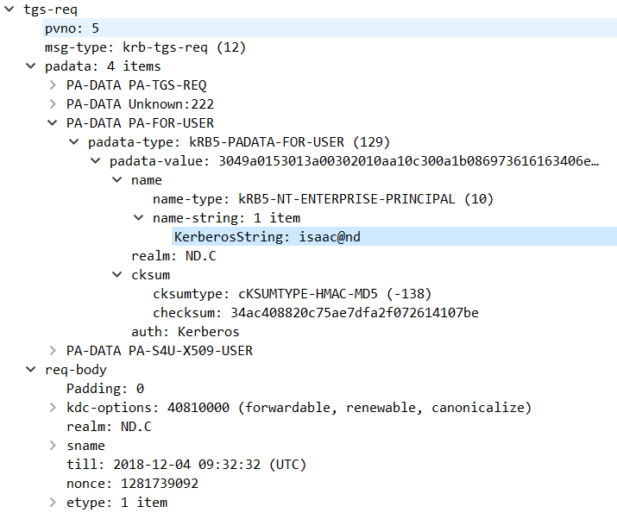
MS-SFU 2.2.1 PA-FOR-USER:
The PA-FOR-USER padata value is protected with the help of a *keyed* checksum, as defined below...

Slide 6
CVEs related to S4U2Self
Samba CVE-2018-16853: A user in a Samba AD domain can crash the MIT KDC by requesting an S4U2Self ticket.
https://github.com/samba-team/samba/commit/6ab51b2af90f5dca11b8587b2a16215ab4497069
https://github.com/samba-team/samba/commit/6c453aeb0c771d14fe501e9a37d9f51b9403872b
MIT Kerberos CVE-2018-20217: Reachable Assertion. If an attacker can obtain a krbtgt ticket using an older encryption type (single-DES, triple-DES, or RC4), the attacker can crash the KDC by making an S4U2Self request.
https://github.com/krb5/krb5/commit/94e5eda5bb94d1d44733a49c3d9b6d1e42c74def
Samba CVE-2018-16860 / Microsoft CVE-2019-0734: S4U2Self with unkeyed checksums.
https://github.com/samba-team/samba/commit/43958af1d50f0185e21e6cd74110c455ee8996af
A python tool for intercepting and manipulating Kerberos packets, can be used to test KDC handling of unkeyed S4U2Self requests:
https://github.com/iboukris/S4U/blob/master/kintercept/kintercept.py

